Slide 1
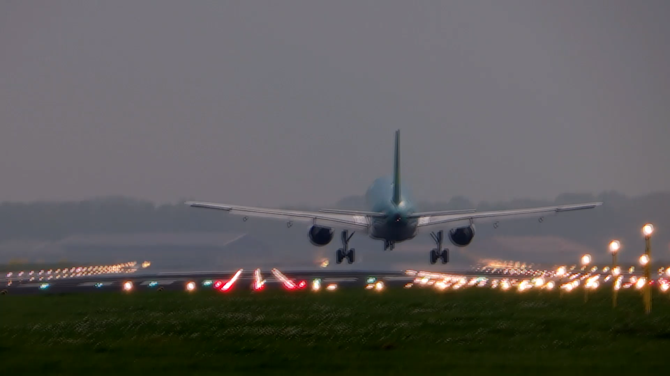


Slide 2
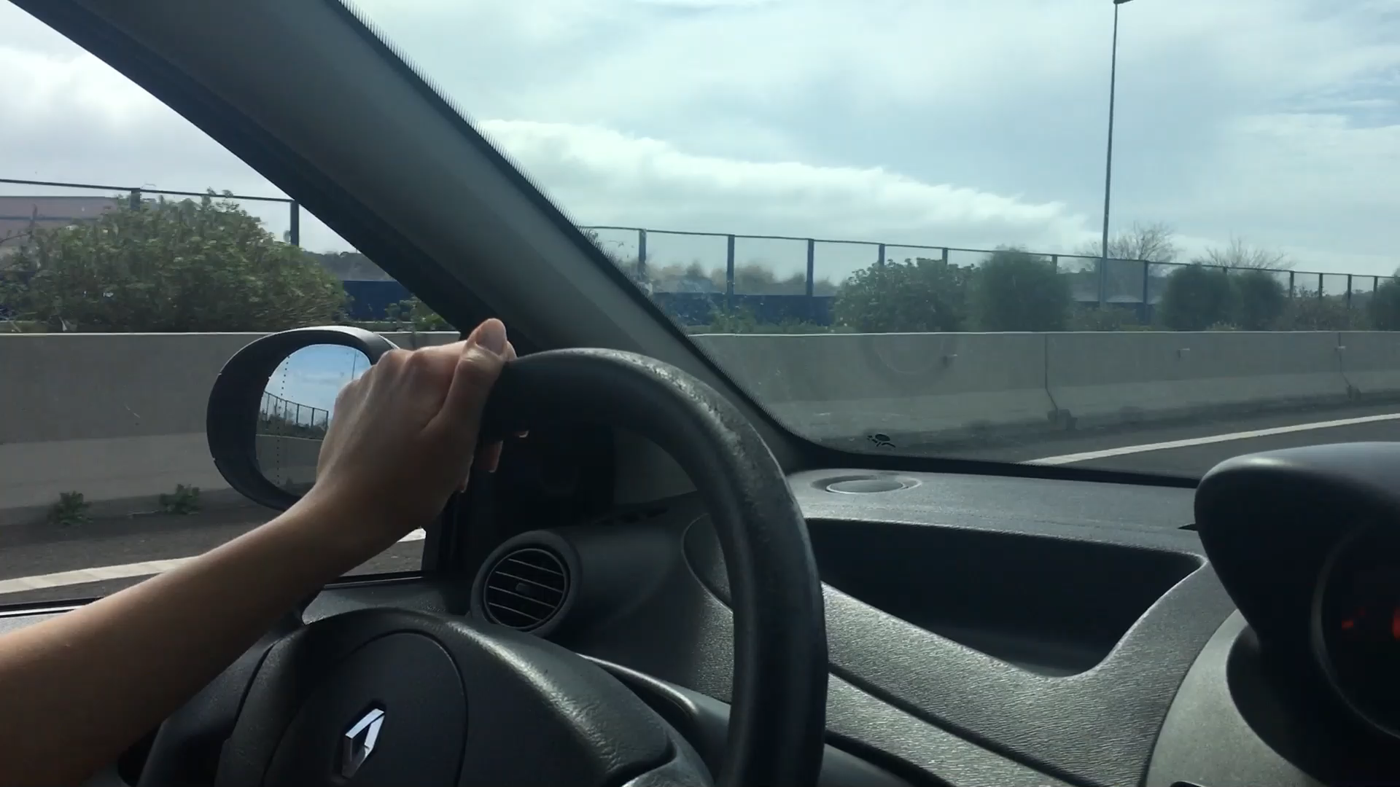
Summary
Air travel is much safer compared to road travel
Passengers choosing air travel are going up year by year
No drop is expected in ticket sales due to safety reasons

Slide 3

Sources:
Federal Aviation Administration
National Highway Traffic Administration
Aviation Safety Network
World bank Passenger Data

Slide 4
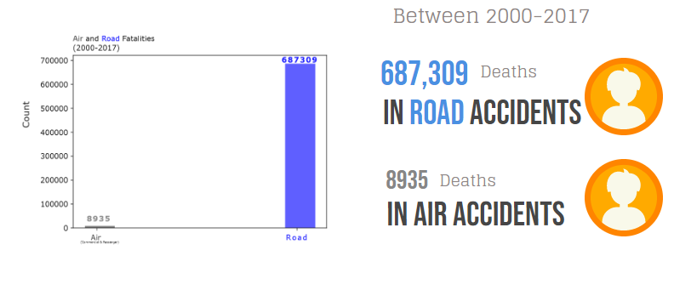

Slide 5
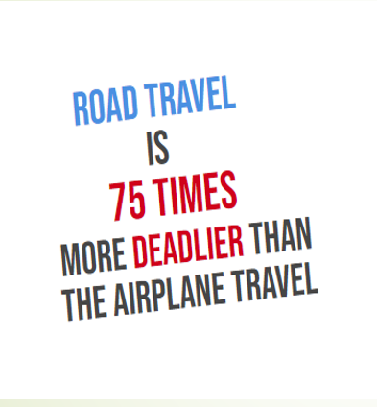
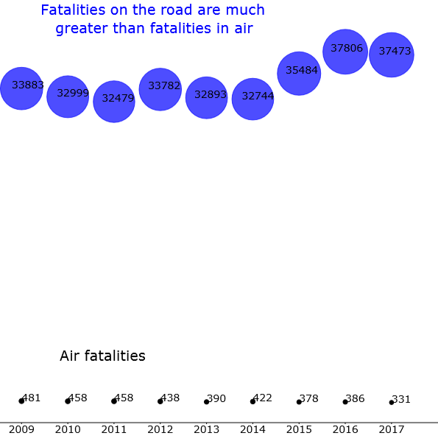

Slide 6
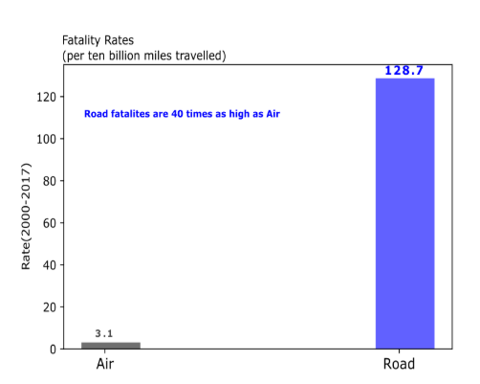
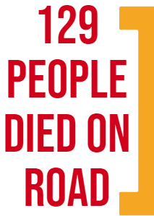
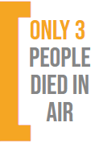

Slide 7
Air Travel is Safer Compared to Road Travel

Slide 8

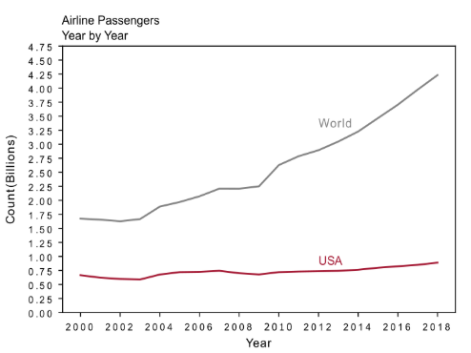
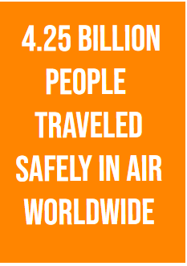

Slide 9
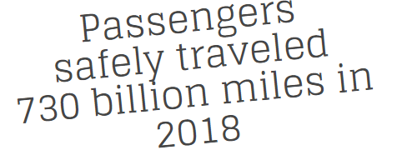
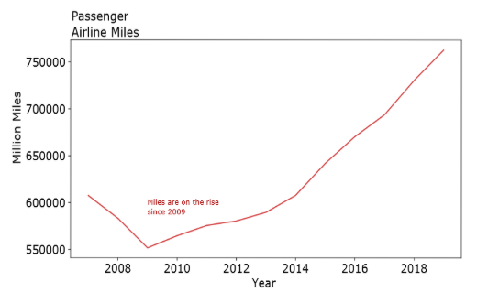

Slide 10


